Slide 1
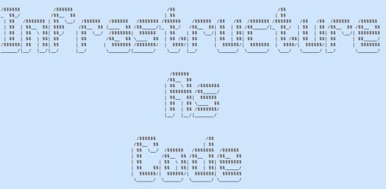
Notes:
This is not for everyone, adapt pieces to fit your needs/project/culture
“Failing with Style”
Run tests against you code

Slide 2


from
Notes:
Testing gets work done quickly
Quality != Fast
Quality enables delivery speed
Quality is #1
Changes can be made quickly with automated tooling that prevents issues or allows them to be found quickly

Slide 3
Shorten the FeedBack Loop
Integrate testing with implementation
Continuously test
Testing and Fixing is part of your daily workflow
Notes:
Working on issues as they arise helps keep it fresh in your mind
Scope of the changes are so small that it is a quick and easy fix

Slide 4
Automated Tests and docs for Fast Feedback
Continuously write tests
Get everyone involved
Start small
Build a good habit of building tests and documentation
Notes:
Large test suites only test at a high level, take a lot of time for a comprehensive test
The system changes too quickly, you are always updating your testing system causing delays
If everyone is involved, you know what to test as you build out the environment
Relevant tests are updated as the code changes by fixing the failing tests

Slide 5
Build a Test Suite
Determine what systems and components you are going to interact with
Write tests for each new feature or bug fix
Build the habit of writing tests and documentation as you go
PSScriptAnalyzer, Pester, ServerSpec, etc
Notes:
Don’t get hung up on the tools
Figure out how you are going to test and determine what your workflow is going to be

Slide 6
What We Do Today
Make a Change
Ad-hoc Testing (if there is time)
Keep an eye on it for minutes/hours
Move on to the next fire

Slide 7
How do we fix it?
Make testing and quality part of your job
Share this ownership with LoB Testers
Write tests before you code
Write help before/as you code

